Slide 1
Hospital Database Project
Zachary Parkhurst CS250 Spring 2022

Slide 2
The Problem
Design a Databse that a Hospital can use daily in its operations
Store employee information
Store patient information
Store payment data
Store building information
Store medicine information

Slide 3
Employee Information
Multiple tables will be used for the employees
The nurses and physicians will have separate tables
There will also be a department table that will have the nurse/physician specialties

Slide 4
Patient Information
There will be multiple tables for this information as well including:
One for contact information
Not null id, last name
Treatment plan (doctor, nurse, medicine, surgery)
Appointments
Possible surgeries

Slide 5
Payment Data
Multiple tables
Will store data on payments
Money owed/paid
Payment method (not null)
Insurance number
Payment number (unique)

Slide 6
Building Information
Single table
Data on the building such as:
Room number
Floor number
Type of room such as surgical room, sterile, storage

Slide 7
Medicine Information
Single table
Stores data on medicine
Various treatment information such as frequency, amount, name, id number

Slide 8
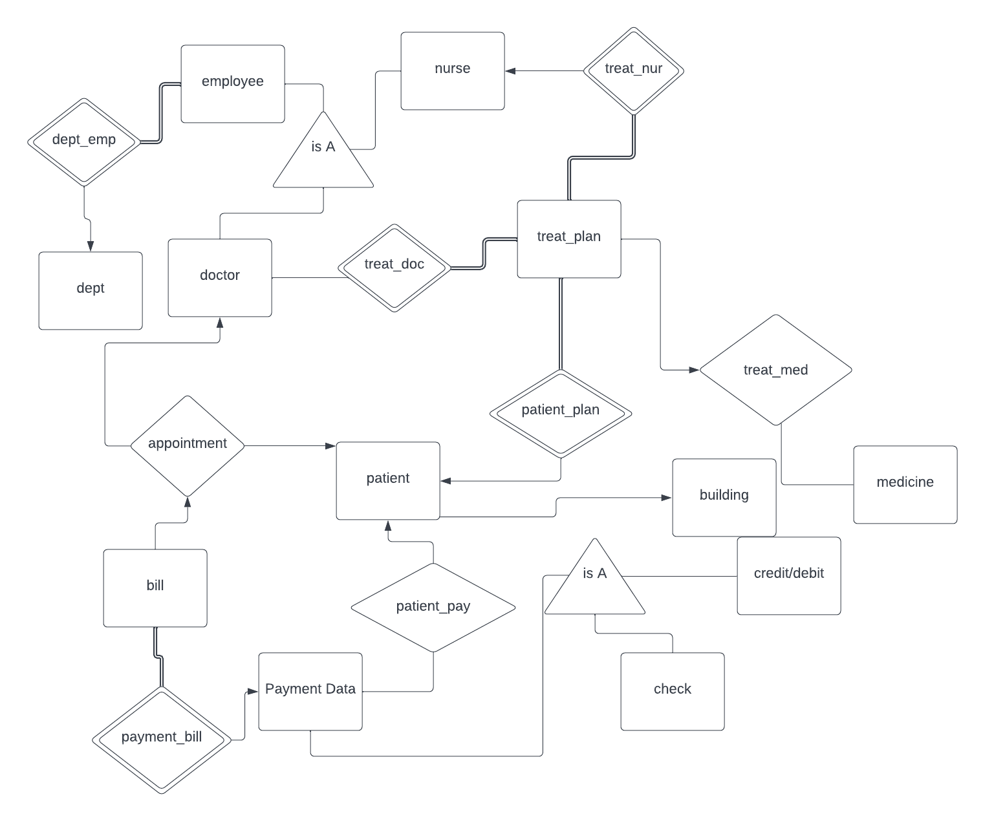
ER Diagram

Slide 9
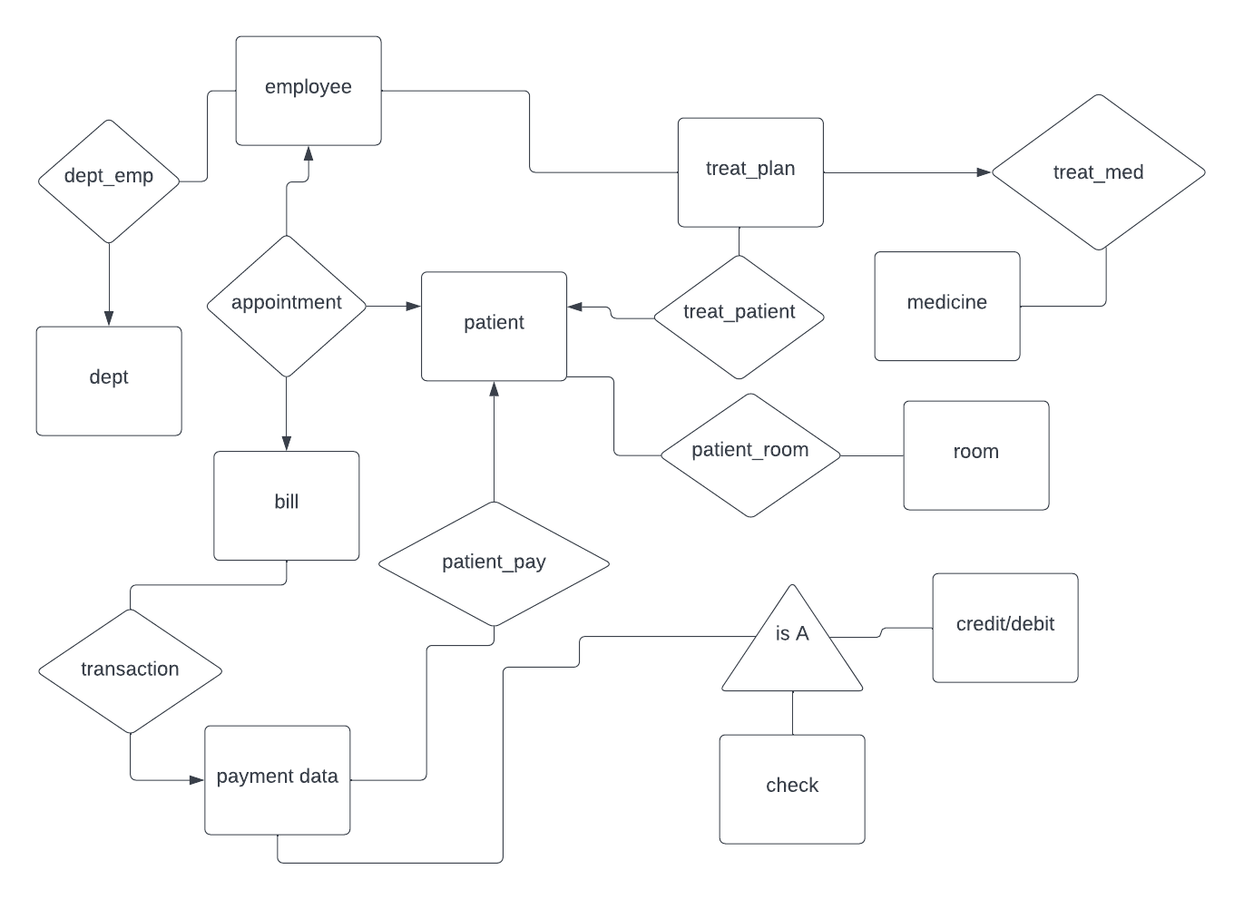
Updated ER Diagram

Slide 10
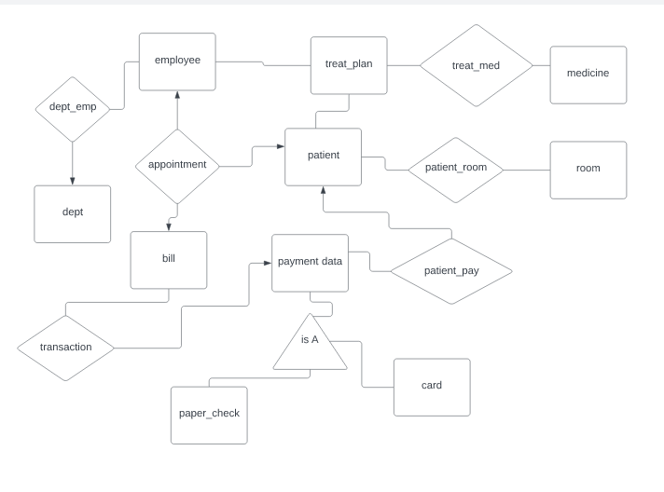
Final ER Diagram

Slide 11
Relational Schema
Underline= Primary key
Italics= Foreign key
dept(name, supervisor)
Dept_emp(emp_id, dept_name)
employee(id, f_name, l_name, email, phone_number, address, dob, salary)
patient(patient_id, f_name, l_name, email, phone_number, address, dob, age)
patient_room(room_number, patient_id)
room(room_number, floor_number, description)
medicine(id, name, brand, description)

Slide 12
Relational Schema
Underline= Primary key
Italics= Foreign key
treat_plan(treat_id, emp_id, patient_id)
bill(bill_number, money_owed, money_paid)
appointment(appt_number, emp_id, patient_id, bill_number)
payment_data(payment_id, method, insurance_number)
patient_pay (payment_id, patient_id)
treat_med(plan_id, med_id, treat_id)

Slide 13
Relational Schema
Underline= Primary key
Italics= Foreign key
card(payment_id, card_number, exp_date, cvv, name_on_card)
Paper_check(payment_id, check_number, acct_number, routing_number, amount, memo, date)
transaction(trans_id, bill_id, payment_id, amount)

Slide 14
Knowledge Applied
In this project, I used:
SQLite
ER Diagrams
Relational Schema
Triggers
SQLite in Python
Protection against SQL injection

